Slide 1
Probability, Bayes Theorem, its applications and their applications
Yogesh Padmanaban

Slide 2
Set Language
Set is collection of well defined objects .
A Room has Adam (wt=60kg), Barbara(wt=50kg) , Njango(wt=70)
Sample Space also called as Universal set .
Universal Set : All possible values of consideration in a setup ( S )
Universal set .is also called Sample Space
Set S = weight of people in a room = 60,50,70
Set A = weight of males in a room =60,70
A⌃ = S-A = 50, weight of females in a room
Set B = A^ = 50 = S-A
Empty set = { }
Intersection A∩B = // common elements amongst A and B
Union A∪B= A+B- A∩B // a copy of all elements without duplicates
S
B
A
A∩B

Slide 3
Experiment , Output & Observation
Experiment : Rolling two dices
Output: 5 and 5 shows up on top of dices
Observation A: sum of numbers showing up = 10 (in this case )
Sample set or Universal Set S1 = all possible values in consideration in this setup
= 2 , … 12
Observation B : sum of numbers facing down ( depends upon dices )
Sample set or Universal Set S2 = all possible values in consideration in this setup
= 2 , … 12
Observation C : sum of numbers facing up and down in two dices
Sample Set or Universal Set = all possible values in consideration in this setup
= depends upon dices

Slide 4
Random Variable
Random Variable : A variable which can take a set of values or a set of
function of values or set of functions of random variable .
Random Variable taking set of values :
RV_{K} = wt of kindergarten kids in a room = 15, … ,45
RV_{HS}= wt of Higher Secondary in a room = 45, ..,,90
Random Variable taking set of functions of values :
RV_{Sum} = sum of wt of kindergarten kids in a room = 1000
RV^{j}_{Sum} = sum of wt of kindergarten kids in jth room = 1520
Random Variable taking set of functions of Random Variables
RV_{ratio} = ∑_{j} log (RV^{j}_{Sum} )

Slide 5
Events
An Event is defined as a Random Variable taking a value .
Random Variable RV_{A} = “ Today’s Weather in India “
Universal Set A = humid, rainy , windy , sunny
Random Variable RV_{B} =” having an umbrella “
Universal Set B = with umbrella , without umbrella
Event A is “ rainy day “ or
RV_{A} = “ rainy “
Event B is “ having an umbrella “
RV_{B} = “ with umbrella “

Slide 6
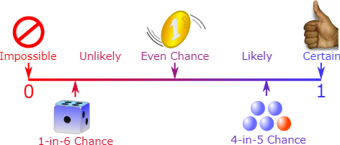
Probability, a measure of chance of an Event
Probability is a measure of chances of an Event. It is a real number from (0,1)
associated with an Event . 0 for an impossible event . It is 1 for a certain event .
Axioms of Probability :
* Probability value is in [0,1]
For instance :
Random Variable A taking values = a1,a2,a0
P(A=a1)=0.5; P(A=a2)=0.5; P(A=a0)=0.0;
P(A=a1) +P(A=a2) + P(A=a0) =1
* If values taken by Random Variable is discrete , it is called as probability mass Function ( pmf )
* If values taken by Random Variate is continuous , it is called as probability Density function ( pdf )
* Sum of all Probability for all possible events is 1 or ∑_{i} P_{i}= 1 (pmf) or ∫ P_{i} =1 (pdf)
* Point-wise Probability value : P(A=a1)
* Probability distribution:
P(A) is distribution of all possible point-wise values P( A = a_{i} ) by A in set S_{A}
Val | P(A=val)
a1 | 0.5
a2 | 0.5
a0 | 0.0

Slide 7
Probabilistic Space and Types Of Models
Probabilistic Space is made of :
* A sample space 𝛀 which is set of all possible outcomes .
* A set of events ℱ where each event is a set containing zero or more outcomes.
* The assignment of probabilities to events .
Types of modelling :
Generative : They models Joint Probability Distribution and subsequently Conditional Probability Distribution is derived eg (
Discriminative : They models directly model Conditional Probability Distribution .

Slide 8
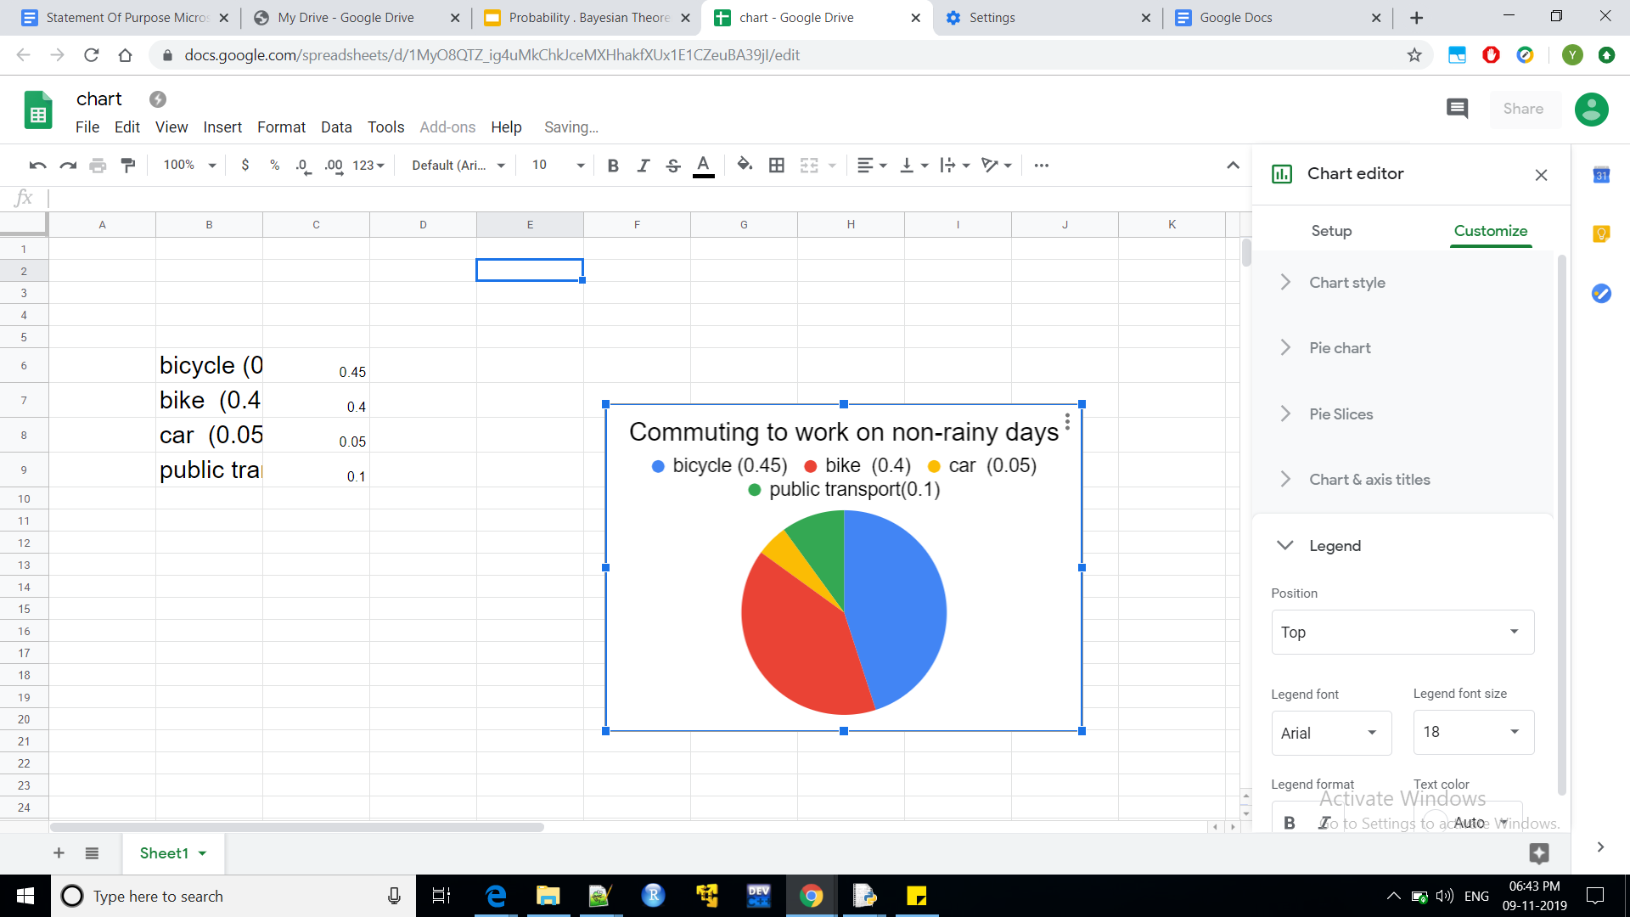
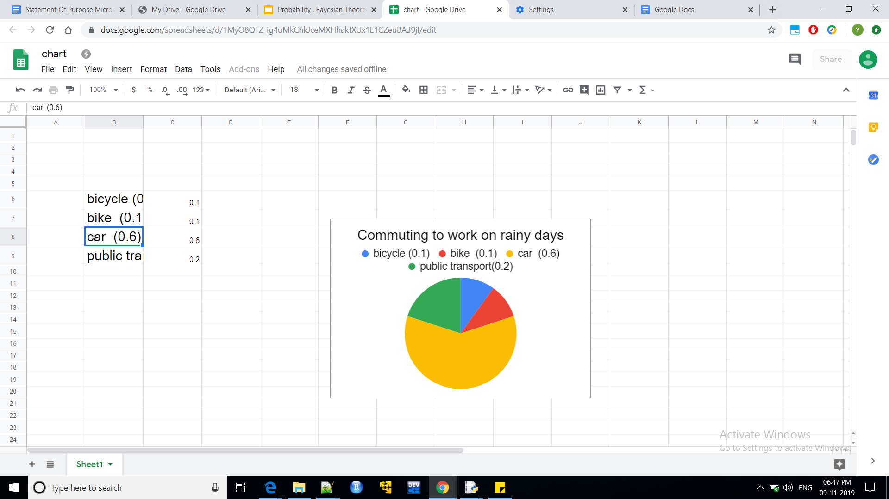
Visualising Probability
Random Variable A is “ commuting to work “
Values = ‘bicycle’ ,’bike’ ,’car’, ‘public transport ‘
On non-Rainy days :
P(A=’bicycle’) = 0.45
P(A=’bike’) = 0.4
P(A=’car’) = 0.05
P(A=’public transport’) = 0.1
On Rainy days :
P(A=’bicycle’) = 0.1
P(A=’bike’) = 0.1
P(A=’car’) = 0.6
P(A=’public transport’) = 0.2
Above collection of Probabilities of Random Variable
For all available values is called Probability
Distribution of A

Slide 9
Probability : axioms and Probability Distribution
* Joint Probability (point wise) : P(A=a1,B=b1, C=c1 , ….): The Probability of collection of Random Variables simultaneously taking values from their corresponding sets of applicable values.
* Joint Probability Distribution : Tabulation of all possible combinations of all possible values of all Random variables considered .
* Conditional Probability : P(A/B)
= P(A∩B) / P(B) for any Events A,B
= P(A) for event A independent of B
* P(A∩B) = P(A/B)P(B) = P(B/A)P(A) for any Events A,B
= P(A)P(B) for event A independent of B

Slide 10
Joint Probability Distribution and Marginal Probability
Joint Probability Distribution : A probability distribution of more than 1 Random variables taking values simultanously.It comprising all possible combinations of random variables tak ing values amongst their individual or common uniserval set .
Sum of all individual probability is 1.
Marginal Probability : It is the Probability distribution of fewer random variables obtained from a Joint Probability distribution via aggregation /summation .
P(A,B) | P(A,B=b) | P(A,B=b0) | P(A)
P(A=a,B) | P(A=a,B=b) | P(A=a,B=b0) | ∑_{B} P(A=a,B)
P(A=a0,B) | P(A=a0,B=b) | P(A=a0,B=b0) | ∑_{B} P(A=a0,B)
P(B) | …. | …. | ….
Marginal Probability

Slide 11
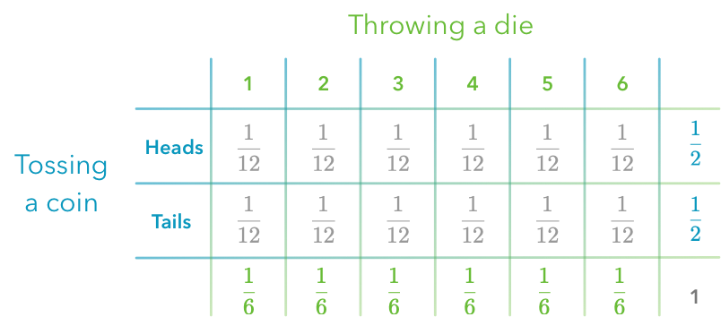
Joint Probability distribution and Marginal Probability
Random Variables
Th =: throwing a dice
C=: coin tossing
Joint Probability distribution, P(Th,C)
Marginal Probability
P(C=j)
Marginal Probability
P(Th=i)
Total Probability
∑_{i} P_{i} =1

Slide 12
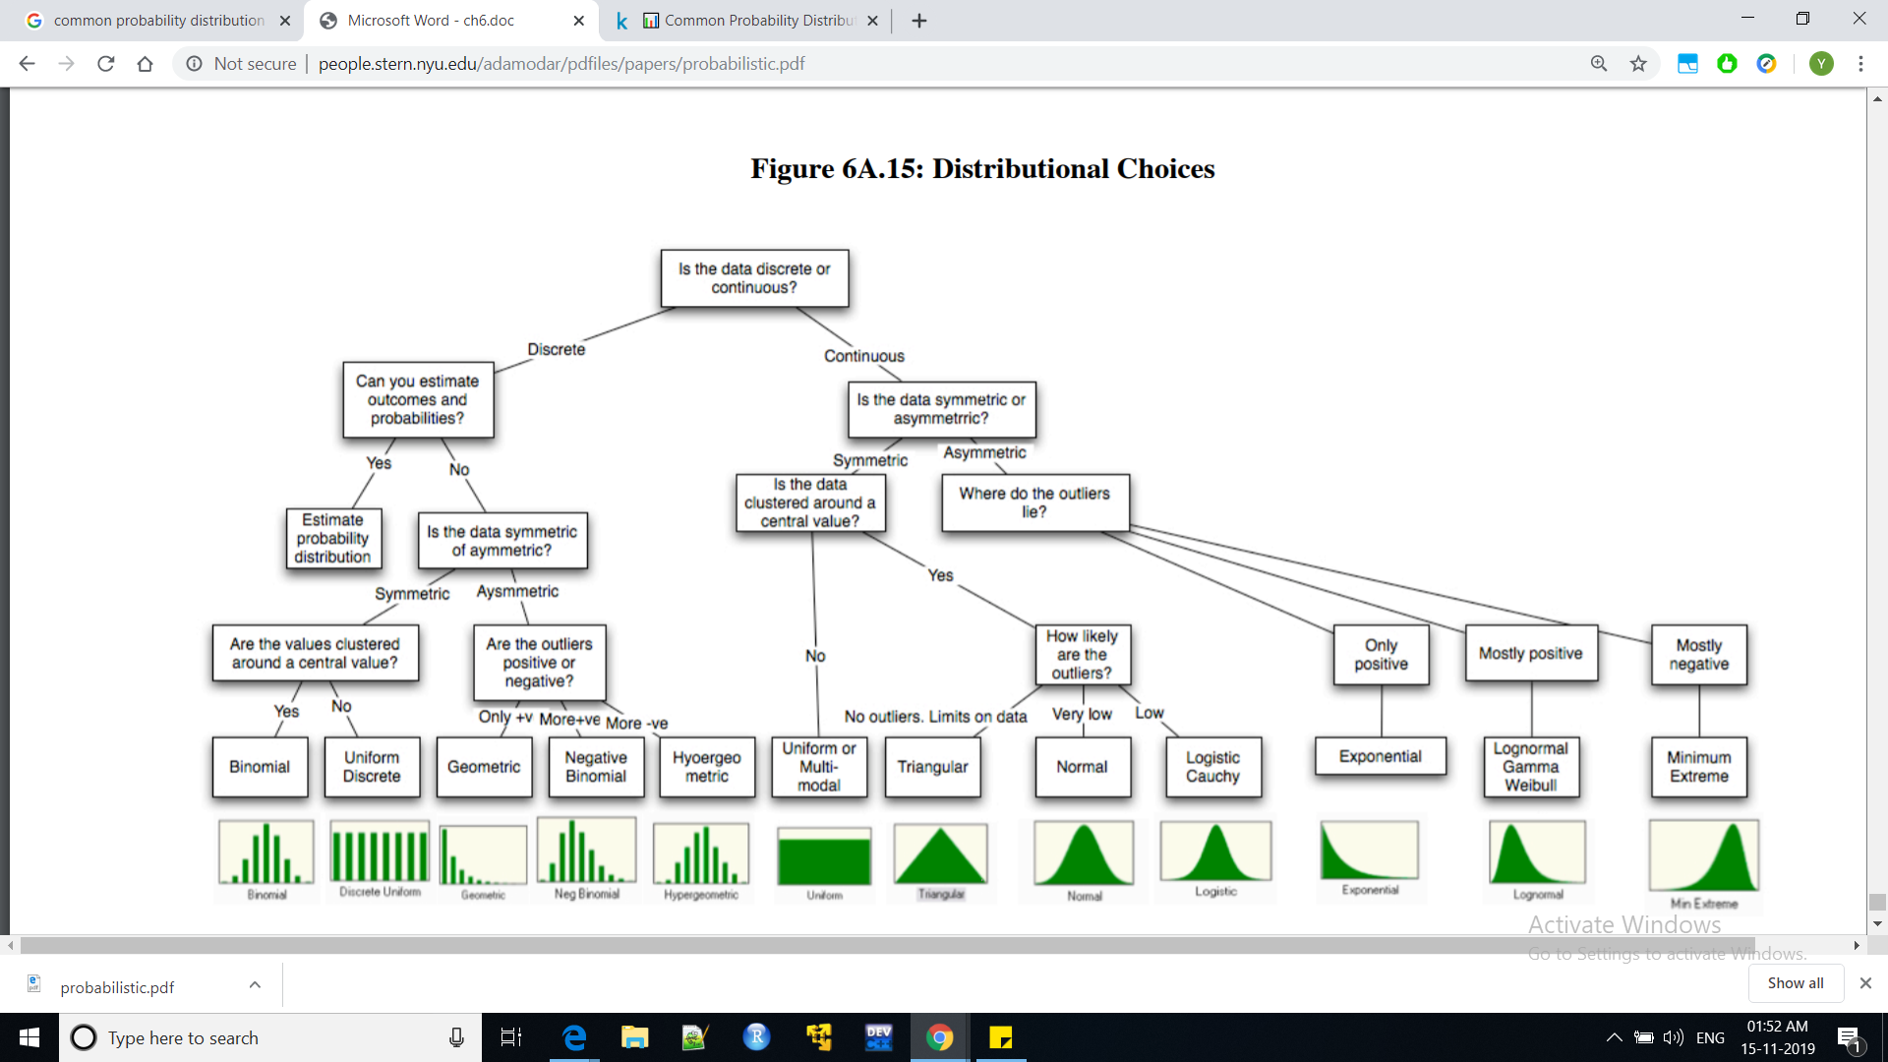
Commonly used Probability Distribution choices

Slide 13
Random Vector and Stochastic Processes
Random Vector: It is a list of Random variables. It is an array of n Random Variables. It is denoted by captial alphabets.
Stochastics Process :
* A stochastic or random process or a random function can be defined as a collection of random variables that is indexed by some mathematical set, meaning that each random variable of the stochastic process is uniquely associated with an element in the set
* The random variables were associated with or indexed by a set of numbers, usually viewed as points in time or a mathematical set .
* It is giving the interpretation of a stochastic process representing numerical values of some system randomly changing over time . For instance , growth of a population.

Slide 14
Probability of Events with notification / evidence
* The Probability of taking an umbrella given that siri said ‘ it might rain today ‘
* The Probability of a noisy colony ( with kids ) on a notification of a public ‘bandh and no school ‘
* The Probability of fishing boats sailing on sea where there is Tsunami warning from coast guard
What will the probability of above events if there was no notifications ?

Slide 15
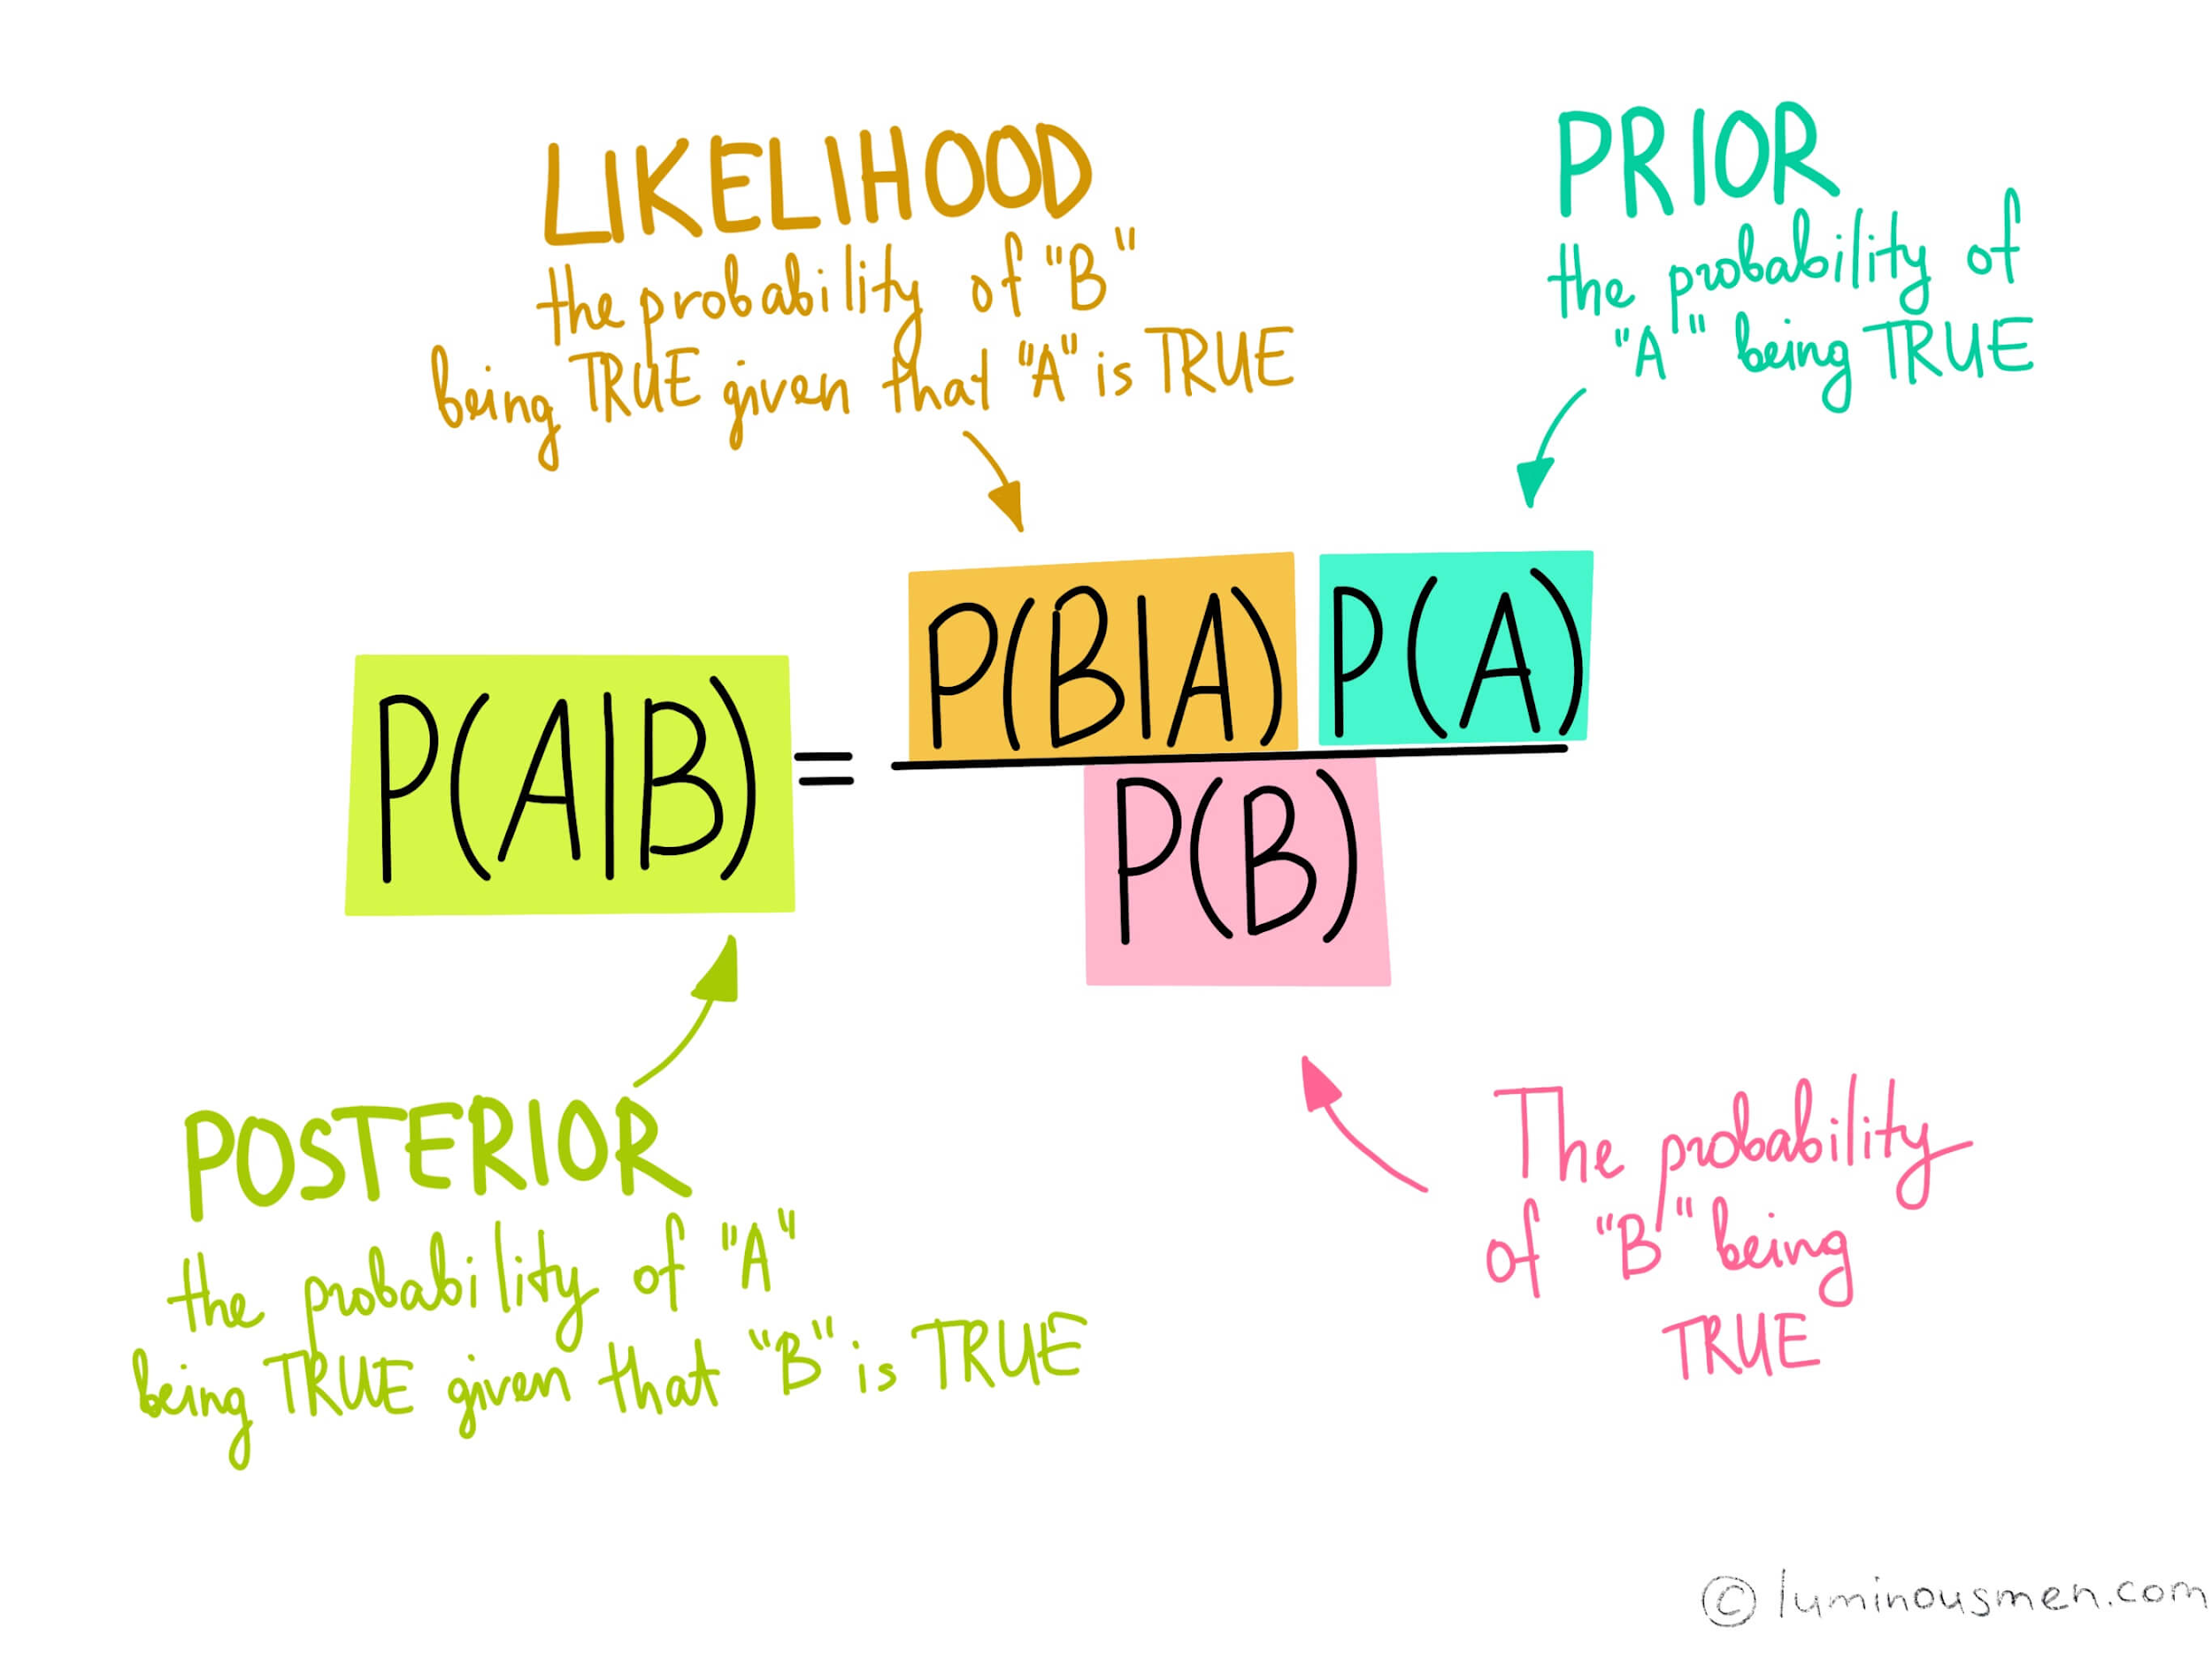
Bayes Theorem
A and B are Events . According to Bayes Theorem for Events A and B. A is similar to notification .

Slide 16
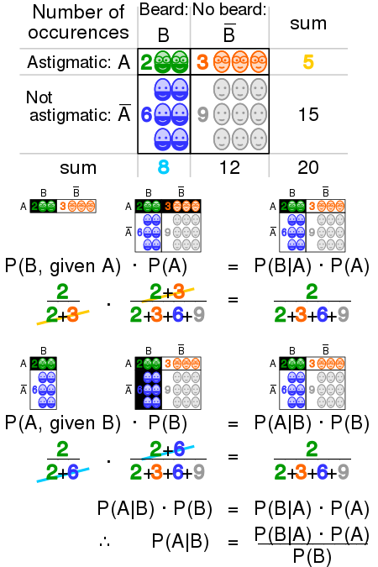
Bayes Theorem,
A Visualisation

Slide 17
Probability of Events (likelihood) with notification (prior)
* The Probability of taking an umbrella ( likelihood ) given that siri said ‘ it might rain today ‘ . Here notification (prior) isnt a certainty but probabilistic .
* The Probability of a noisy colony with kids (likelihood) on a notification of a public ‘bandh’ and no school‘ . (prior)
* The Probability of fishing boats sailing on sea (likelihood) where there is tsunami warning from coast gaurd (prior)

Slide 18
Posterior , prior and likelihood
* What is the Probability of siri saying ‘it might rain’ if an Umbrella has been picked
up? It is called Posterior probability .

Slide 19
Probability vs trials
If probability of a Tails at a coin is 0.5 , will 5 out of 10 toss of that coin be definitely Tails ?
How to identify loaded dice ?
How many trials required for the first Tails of a coin ?
(Geometric Distribution)
Probability is measure of chances on a long term relationship between the values rather than a short term / immediate result.
But still, Confidence intervals can be obtained on how balanced a dice is after several trials with thresholds

Slide 20
Conditioning an Event on an Event
Conditional Probability: It is a measure of the probability of an event occurring
given that another event has occurred .
Independence of an Event A on another Event B : If Event A’s occurence isnt
affected by presence or absence of an Event B or vice-versa then events A and B
are independent . ( A ⊥ B )
P(A ∩ B) = P(A) P(B) for A ⊥ B
Events A is independent of B
Conditioning of Event A on event B: If event A’s occurence is affected by presence
or absence of event B or vice-versa , then events A and B arent independent.
P(A/B) = P(A∩B) if A isn’t independent of B
P(B)
P(A/B) = P(A)P(B) = P(A) If A is independent of B
P(B)

Slide 21
Conditional Independent events
conditional probability is a measure of the probability of an event occurring given that another event has (by assumption, presumption, assertion or evidence) occurred .
Two random events A and B are conditionally independent given a third event C if the occurrence of A and the occurrence of B are independent events in their conditional probability distribution given C.
P( A,B|C) =P(A|C) * P(B|C) => ( A ⫫ B ) |C
In other words, A and B are conditionally independent given C if and only if, given knowledge that C occurs,
knowledge of whether A occurs provides no information on the likelihood of B occurring, and
knowledge of whether B occurs provides no information on the likelihood of A occurring.

Slide 22
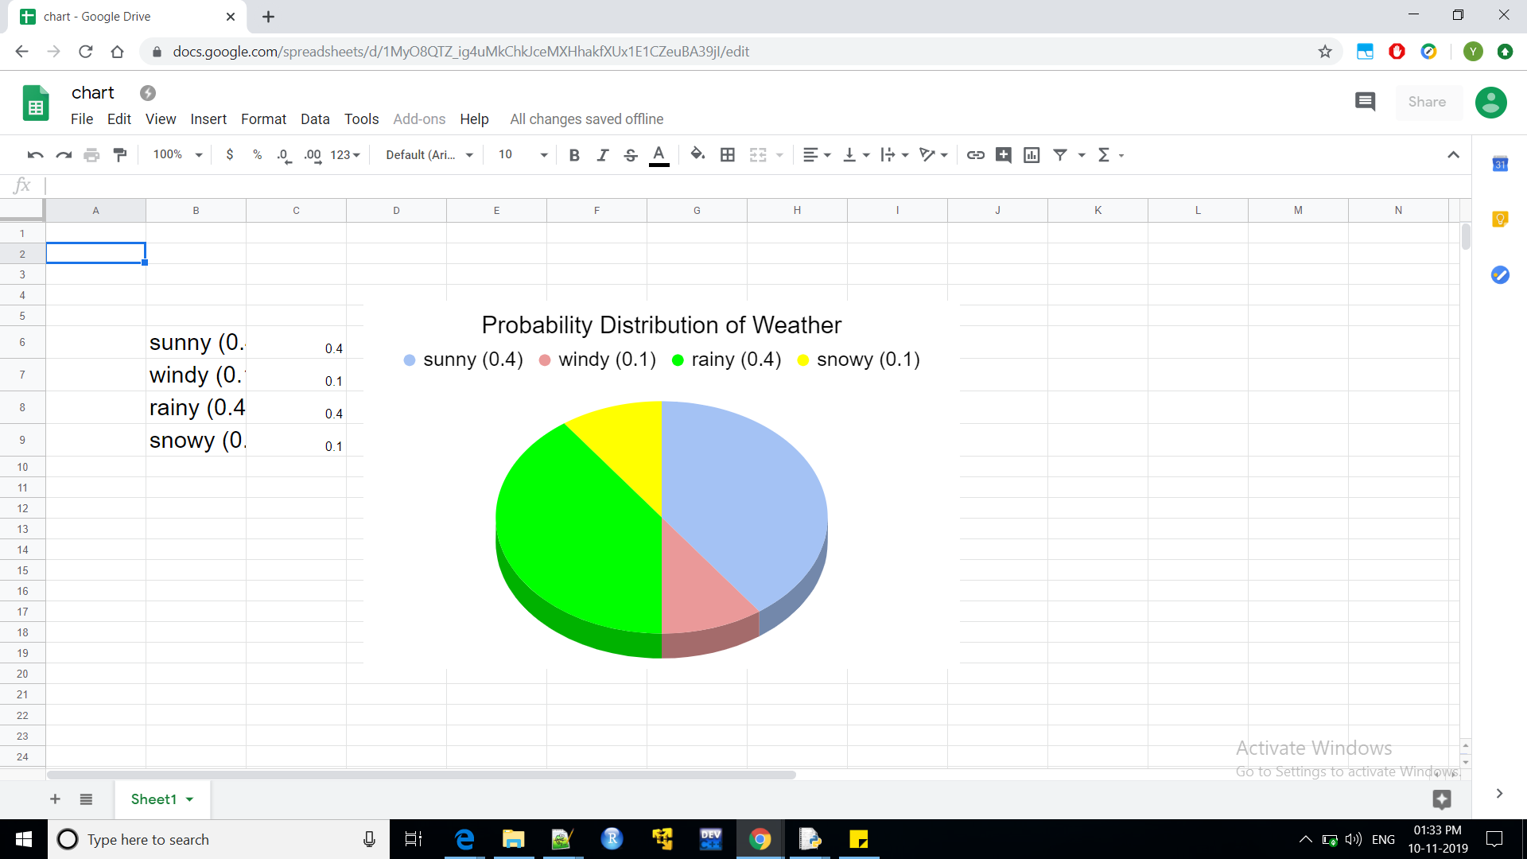
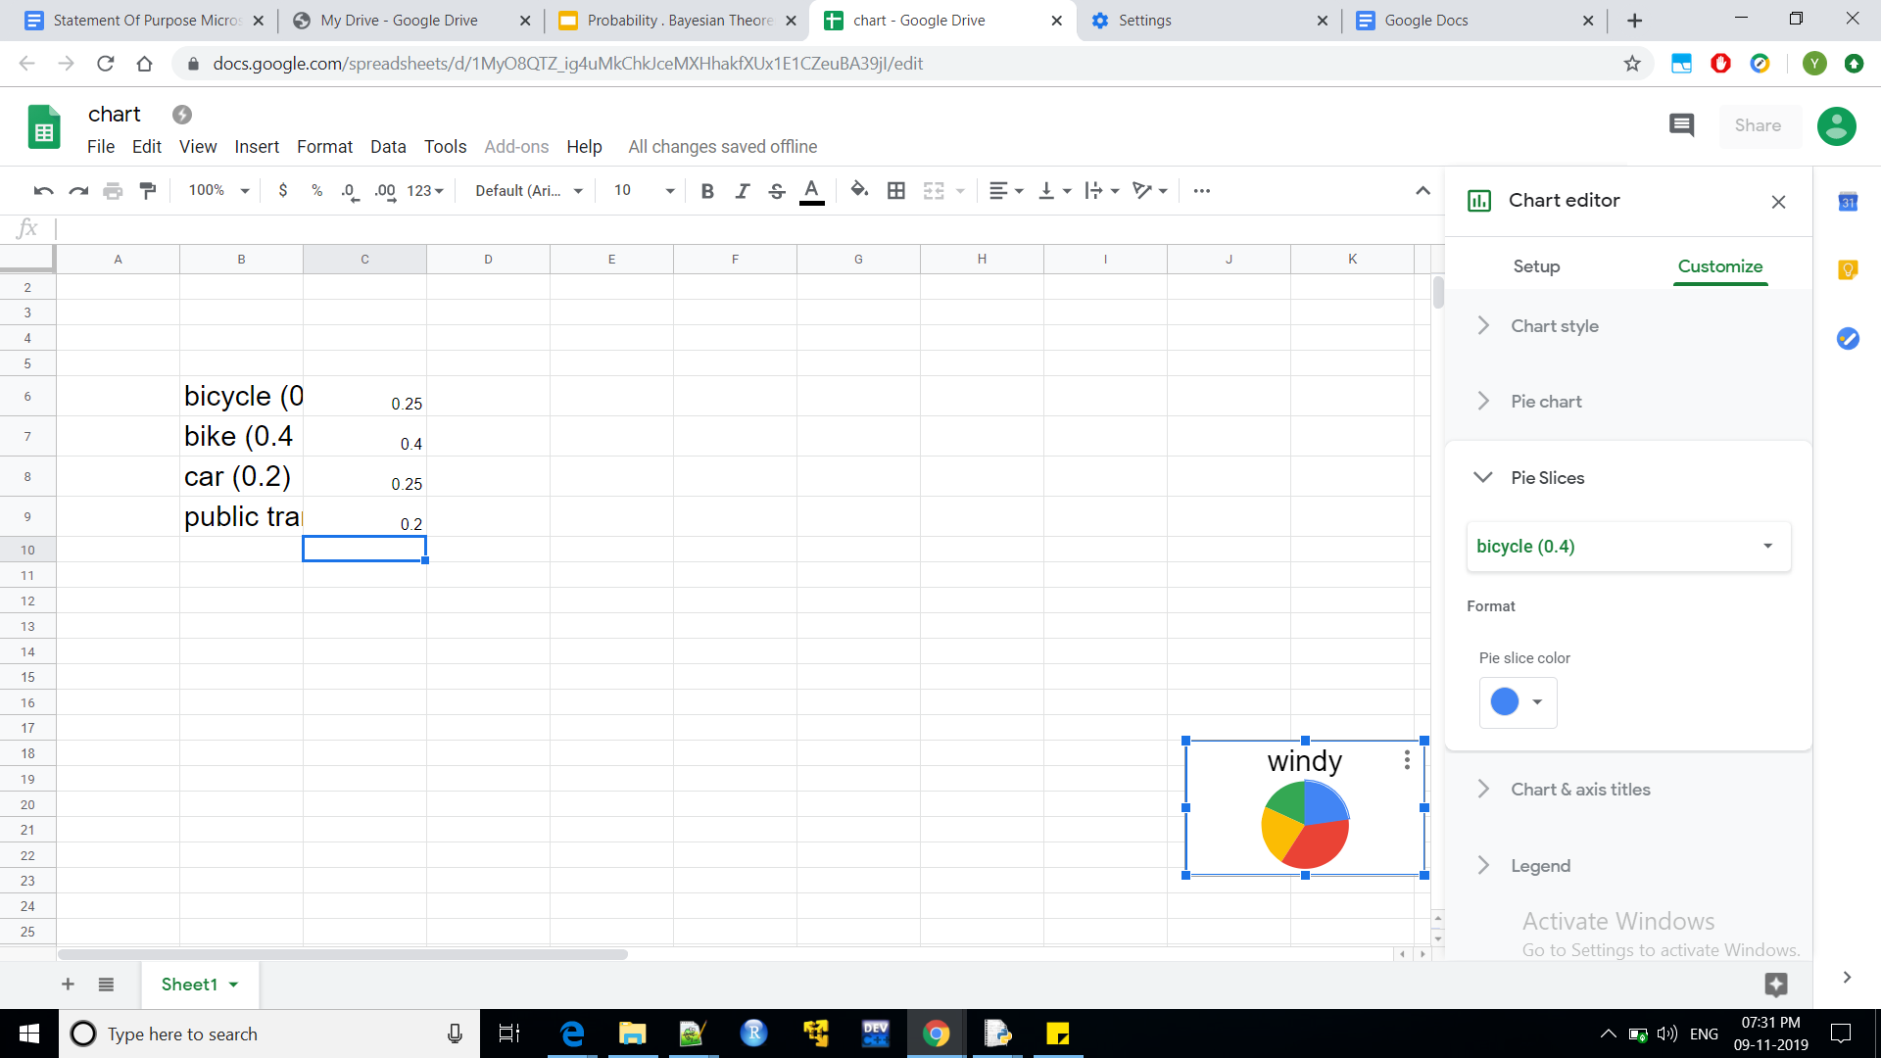
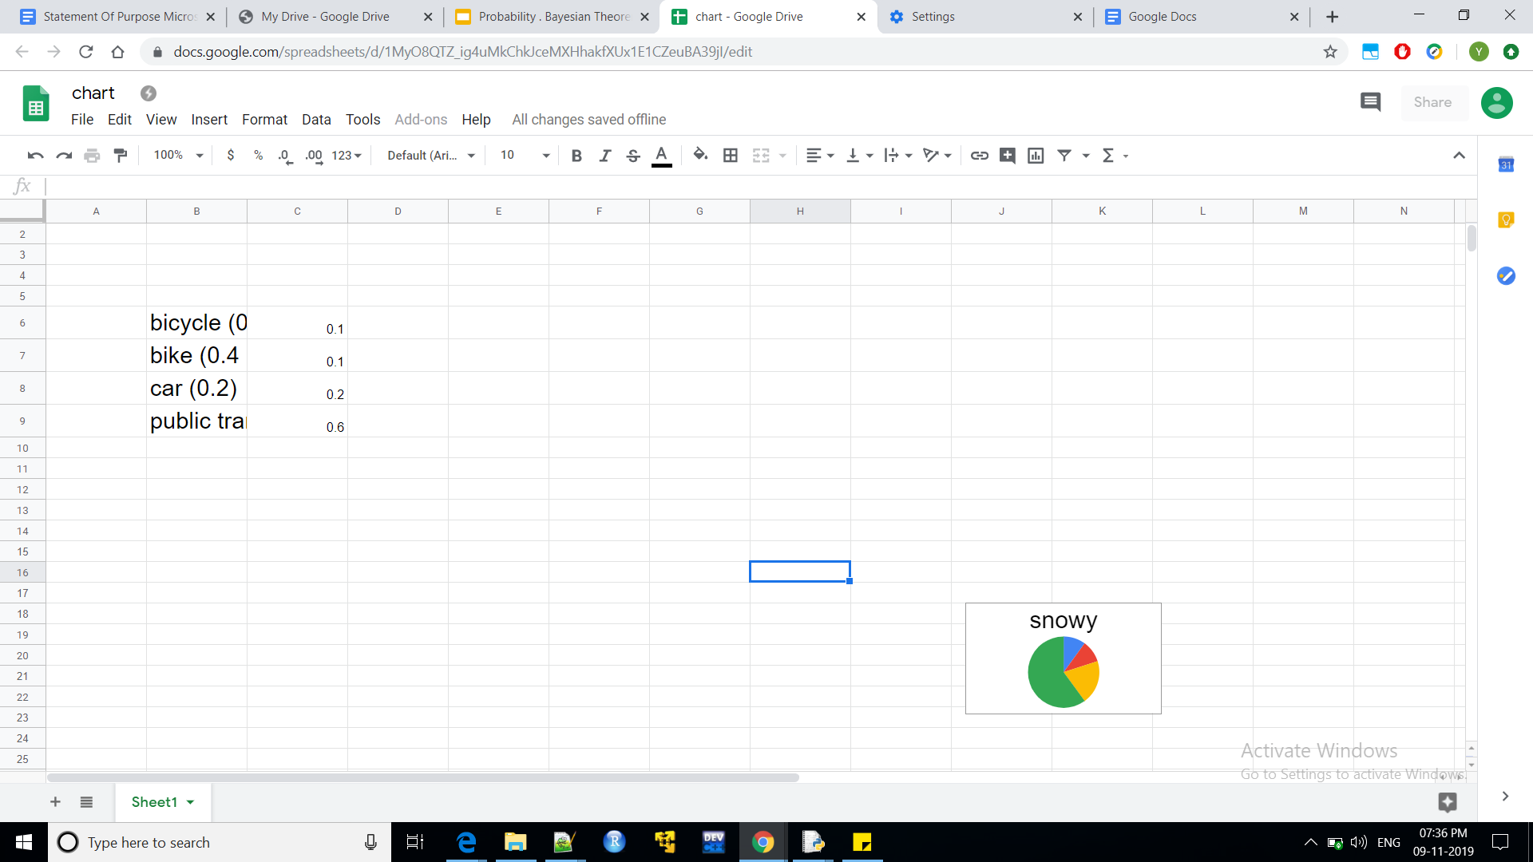
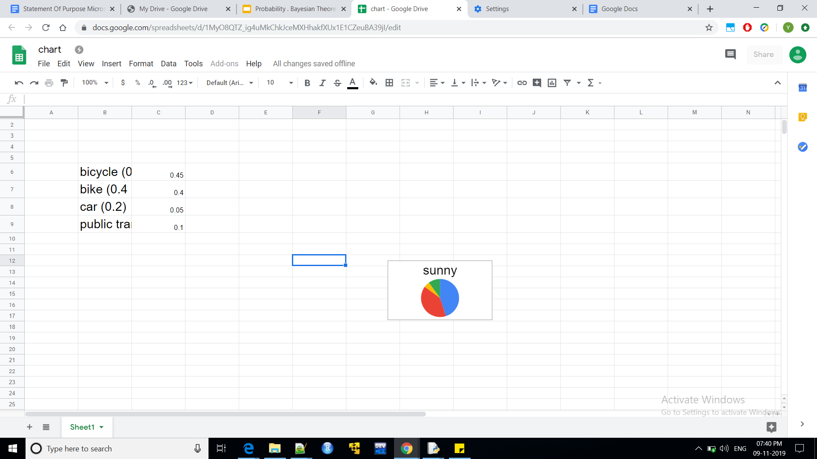
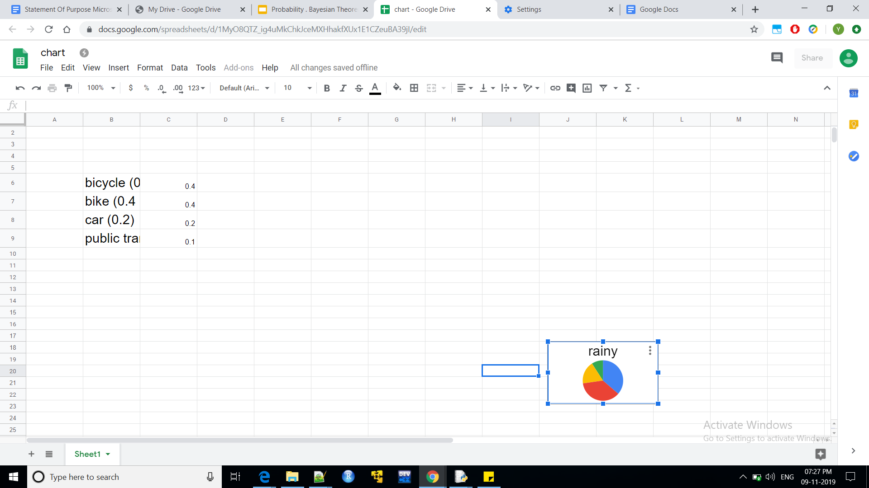
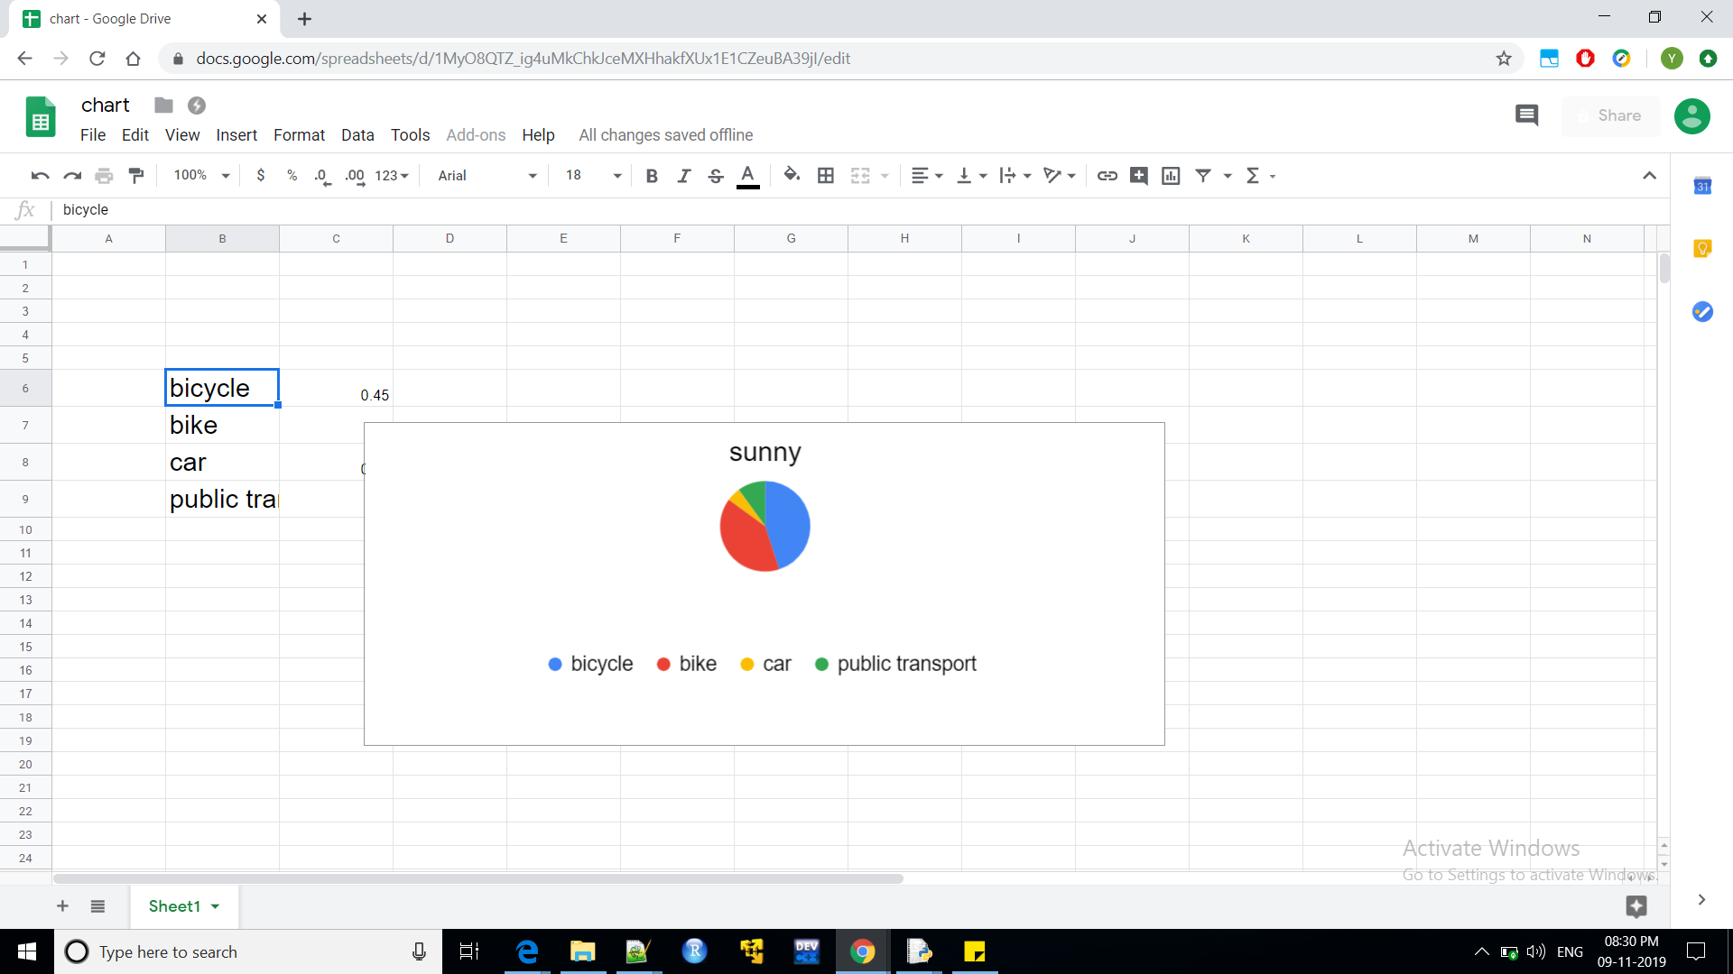
Visualising Conditioning of Events
Random variable A = ‘ today’s Weather ‘
Universal set S_{w}= sunny, rainy,windy,snowy
Random variable B = ‘ today’s Commute ‘
Universal set S_{C}= bicycle,bike,car,public transport
Probability Distributions of various commuting on various Weather

Slide 23
Conditional Probability Distribution of Commuting (2D circle) on Weather (pizza)

Slide 24
Dependent and Independent Random Variables
* An independent random variable is a random variable that doesn't have
an effect on the other random variables in your experiment.
In other words, it doesn't affect the probability of another event happening.
P( A , B) = P(A) * P(B)
* ‘ If Random variable A’s Probability Distribution is affected by presence or
absence of another Random variable B taking any of the values of universal set
S_{B} Or vice versa “ , then A and B are dependent on each other.
* ‘ If Random variable A’s Probability Distribution isnt affected by presence or
absence of another Random variable B taking any of the values of universal set
S_{B} or vice - versa ‘, then Random Variables A and B are independent .

Slide 25
Conditionally independent Random Variables
* Let Omega 𝛀 be sample space and let P( E ) denotes probability of Event 𝚬⊆𝛀
* Suppose that, after assigning probabilites [eq2] to the events in Omega, we receive new information about the things that will happen (the possible outcomes).
* In particular, suppose that we are told that the realized outcome will belong to a set I ⊆ ꭥ (Omega)
*How should we revise the probabilities assigned to the events in Omega, to properly take the new information into account?
* P(E|I) represents new probability with evidence (I) . the revised probability assigned to an event E ⊂ 𝛀 after learning that the realized outcome will be an element of (I). It is called the conditional probability of E given evidence I .
Sample space -> universal set
Intr lin hight
R2 to RR2

Slide 26
Bayes Theorem for multiple variables
For an dependent variable A and a set of independent variables
B B₀ ,B₁, …. B_{k} , … B_{n} , Bayes Theorem states that :
P(A,B₀,B₁, … B_{k} , … B_{n})
= P(A) P(B_{n}, … ,B_{k}, .. B₁,B₀/ A) applying Bayes Theorem
= P(A) P(B_{n}/A) P(B_{n-1} , … , B_{k} , … B₁,B₀/A,B_{n}) applying Bayes Theorem
= P(A) P(B_{n}/A) P(B_{n-1}/A,B_{n}) P(B_{n-2},...,B_{k}, … , B₁ , B₀/A,B_{n},B_{n-1})
This is a generic formulation of a joint Probability function as We aren’t aware of conditional dependency amongst the Random Variables . What if we are aware of conditional dependency amongst them ? we can build a Bayesian Network

Slide 27
Naive Bayes Classifier
If all of the feature variables are assumed to be mutually independent amongst each
other conditioned on target variable “Target” , it is called as naive bayes assumption.
P( f_{i} | f_{i+1} , f_{i+2} ,...., f_{n ,} Target ) = P( f_{i} | Target )
From Joint Probability
P(A,B₀,B₁, ….B_{n}) = P(A) P(B_{n}/A) P(B_{n-1}/A,B_{n}) P(B_{n-2},...., B₁ , B₀/A,B_{n},B_{n-1})
P(Target , f₀, f₁ , f₂, …. f_{n} )
= P(Target) * P(f₀,f₁, ….f_{n}| Target ) (using Joint Probability )
= P(Target) * P(f₀|f₁,f₂, …. f_{n},Target) * P(f₁,f₂,....,f_{n}|Target )
= P(Target ) * P(f₀|Target) * P( f₁,| f₂, …. , f_{n},Target) (using naive Bayes assumption)
….
= P(Target) * P(f₀|Target) * P( f₁|Target ) , …. , P (f_{n}|Target)
Naive Bayes is faster for implementation can be a baseline for other classifiers .

Slide 28
Naive Bayes Classifier (continuing )
From Conditional Probability
P(Target | f₀,f₁, …. ,f_{n} )
= P(Target , f₀ , f₁, …. ,f_{n}) / P( Target )
(From last equation )
= P( Target ) * P (f₀|Target ) * P( f₁| Target ) * …. * P ( f_{n} | Target ) / P (Target)
= P(f₀ | Target ) * P ( f₁ |Target ) * …. * P (f_{n} |Target)
Naive Bayes Classifier is fast to implement and can be a baseline for other classifier .

Slide 29
Bayesian Network
Bayesian Network is a DAG(Directed acyclic graph) of nodes and edges .
Nodes representing random variables and edges representing conditional
dependency amongst them .
It is also used for representing causality .
According to this BN ,
P(A,B,C,D,F,G,H,I,J)
= P(A) * P(B|A) * P(C|A) * P(D|A,C)* P(H|C)
*P(F) * P(G|H,C,B,F) * P(I|G) * P(J|D,H,G)
Conditionaly Independent Vars : A , F
Dependent Vars : B,C,G,H,I,D,J
F
I
B
G
A
C
H
J
D

Slide 30
Bayesian Networks Inference
* To Fully represent the joint probability distribution, it is necessary to specify for each node X the probability distribution for X conditional upon X's parents. The distribution of X conditional upon its parents may have any form
* Exact Inference from BN using variable elimination is “NP-HARD” .
* Approximate inference algorithms:
importance sampling (reducing variance )
stochastic MCMC(Markov Chain Monte Carlo) simulation (avoids local minima ; Gibbs Sampling)
belief propagation ( sum product Algorithm with O(n^2) Ops )
variational methods (variational Bayes)
* Param Learning : Expectation Maximisation is an approach to maximise likelihood or posterior
probability by alternating between computing Expectation and maximisation in an iteration .

Slide 31
Bayesian Network Inference - Variable Elimination
* It eliminates (by integration or summation) the non-observed non-query variables one by one
by distributing the sum over the product;
* This method have complexity that is exponential in the network's treewidth.
* According to this BN ,
Computing for P(A) and P(F) and eliminating conditionally
Independent variables.
P(A,B,C,D,F,G,H,I,J)
= P(A) * P(B|A) * P(C|A) * P(D|A,C)* P(H|C)
*P(F) * P(G|H,C,B,F) * P(I|G) * P(J|D,H,G)
Conditionally Independent Vars : A , F,B,C
Dependent Vars : G,H,I,D,J
F
I
B
G
A
C
H
J
D

Slide 32
Bayesian Network Inference - Variable Elimination
Computing P(B|A) , P(C|A) , and eliminating conditionally independent variables .
According to this BN ,
P(A,B,C,D,F,G,H,I,J)
= P(A) * P(B|A) * P(C|A) * P(D|A,C)* P(H|C)
* P(F) * P(G|H,C,B,F) * P(I|G) * P(J|D,H,G)
Conditionally Independent Vars: A , F, B , D , C , H
Dependent Vars : G,I,J
B
F
I
A
C
G
H
J
D

Slide 33
Bayesian Network Variable Elimination
Computing for P(D|A,C) , P(H|C) and eliminating conditionally independent variables
According to this BN ,
P(A,B,C,D,F,G,H,I,J)
= P(A) * P(B|A) * P(C|A) * P(D|A,C)* P(H|C)
*P(F) * P(G|H,C,B,F) * P(I|G) * P(J|D,H,G)
Conditionally Independent Vars : A , F , C,H,D,B, G
Dependent Vars : I,J
F
I
B
G
A
C
H
J
D

Slide 34
Bayesian Network Inference - Variable Elimination
Computing P(I|G) and P(J|D,H,G) for inferring I and J
According to this BN ,
P(A,B,C,D,F,G,H,I,J)
= P(A) * P(B|A) * P(C|A) * P(D|A,C)* P(H|C)
*P(F) * P(G|H,C,B,F) * P(I|G) * P(J|D,H,G)
conditionally Independent Vars : A , F ,B , C, G ,H , I , D , J
Dependent Vars :
F
I
B
G
C
A
H
J
D

Slide 35
Markov Blanket
Markov Blanket :
It is the collection of nodes around a given Random Variable which is sufficing to explain the given Random Variable.
Only the distribution of these variables are needed to find probability distribution of the random variable in a bayesian network.
Parent, siblings and child nodes of given Node collectively called as Markov Blanket.
For Random Variable C, Markov Blanket is
{ A, B, F, H, G, D }
F
I
B
G
A
C
H
D
J

Slide 36
Combinatorial Explosion of Bayesian Networks Inference
Knowledge Of Architecture | Number of nodes | Inference Technique
unfamiliar | <1000 / >1000 | MCMC Sampling and model Sampling
familiar | >1000 | MCMC Sampling (Gibbs) , EM , ,variational Bayes
familiar | <1000 | MCMC Sampling (Gibbs),EM , variational Bayes

Slide 37
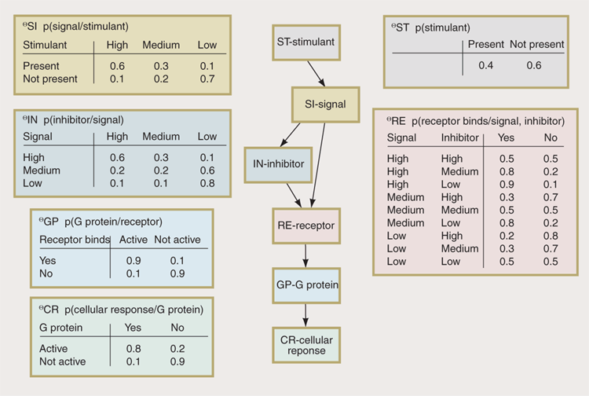
Sample Bayesian Network
Markov Chain First Order

Slide 38
Bayesian Network Inference - Importance Sampling
*Importance sampling is a variance reduction technique that can be used in the Monte Carlo method.
*The idea behind importance sampling is that certain values of the input random variables in a simulation have more impact on the parameter being estimated than others.
*If these "important" values are emphasized by sampling more frequently, then the estimator variance can be reduced.
*Hence, the basic methodology in importance sampling is to choose a distribution which "encourages" the important values.

Slide 39
Markov Chain Monte Carlo ( MCMC )
* It is a sampling method which characterize a distribution without knowing all of the distribution’s mathematical
properties by randomly sampling values from a sequential process ( Markov Chain ) values out of the distribution
* By constructing a Markov chain that has the desired distribution as its equilibrium distribution, one can obtain a sample of
the desired distribution by recording states from the chain.
* The more steps that are included, the more closely the distribution of the sample matches the actual desired distribution.
* Various algorithms exist for constructing the Markov chain including the Metropolis–Hastings algorithm.
* Each random sample is used as a stepping stone to generate the next random sample (hence the chain). It is usually
followed when obtaining properties from Distribution’s equation is hard.
* it can be used to draw samples from distributions even when all that is known about the distribution is how to calculate
the density for different samples.
* Monte–Carlo is the practice of estimating the properties of a distribution by examining random samples from the
distribution.
* It is sequential and hard to parallelize ( Gibbs Sampling is hard to distributably compute )

Slide 40
Metropolis Hastings Sampling
* The Metropolis–Hastings algorithm is a Markov chain Monte Carlo (MCMC)
method for obtaining a sequence of random samples from a probability
distribution from which direct sampling is difficult.
* This sequence can be used to approximate the distribution (e.g. to generate a
histogram) or to compute an integral, an expected value
* Metropolis–Hastings and other MCMC algorithms are generally used for
sampling from multi-dimensional distributions, especially when the number of
dimensions is high usually following euclidean space .
* The problem of autocorrelated samples ( a signal is correlated to a copy of
itself and by a function of lag ) is inherent in MCMC methods.

Slide 41
Metropolis Hastings Sampling & Gibbs Sampling
* The Metropolis–Hastings algorithm can draw samples from any probability
distribution P(x), provided that we know a function f(x) proportional to the
density of P and the values of f(x) can be calculated.
* The requirement that f(x) must only be proportional to the density, rather than exactly equal to it, makes the Metropolis–Hastings algorithm particularly useful, because calculating the necessary normalization factor is often extremely difficult in practice.
* The Metropolis–Hastings algorithm works by generating a sequence of sample values in such a way that, as more and more sample values are produced, the distribution of values more closely approximates the desired distribution P(x)

Slide 42
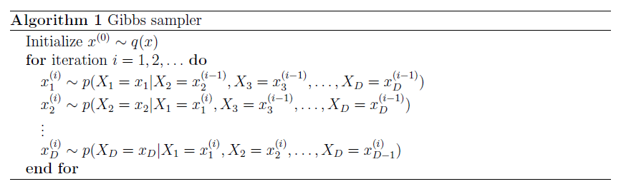
Gibbs Sampling
The idea in Gibbs sampling is to generate posterior samples. by covering
through each variable (or block of variables) to sample from its conditional
distribution with the remaining variables fixed to their current values.
* Iterations till saturation or convergence or till computing resources are availed.

Slide 43
Expectation Maximisation
It is a technique for optimising a function with parameters.
Initial parameters of an objective function are initialized with random values or priors ( dirichlet or gaussian or a sampling output ) .
After initialisation , an iteration consists of two following steps .
Computing Expected value of a Function with right set of parameters
Computing Maximising of function to obtain right set of params with earlier values as initial .
Till saturation or convergence or a deadline of the project or a consummation of a need of computational resource , number of iterations is increased .

Slide 44
Factor Graph and Sum-Product Algorithm
* Factor Graph is a bipartite graph with nodes round (Random Variable) for computing marginal Probability
and square node (factor obtained through factorization of a function for reducing number of ops )
which is for computing aggregation of conditional probability and square nodes for and edges represent
conditional dependency.
Obtaining marginal probability recursively from summation of joint probability which is a summation of
product of conditional probability which is a product of joint probability converging is called as Sum-Product
Algorithm.
* Factor graphs provisions a O(N^2) ops to computation of marginal probability. It is to reduce number of
ops which was exponential from brute force .

Slide 45
Factorization
A joint Probability Distribution is a product of conditional probability and marginal
probability. Number of ops for computation in brute force is exponential.
Computation of a joint probability function can also be done in an abstract way
called as factors/ potentials.
If all related/dependent conditional probability and corresponding marginals could
be bunched together denoted as factor f_{i} .
If marginal probability of conditionally independent marginals could be bunched
together denoted as factor f_{j}
Joint Probability = { { Conditional Probability * Conditionally dependent RV’s marginals } * …. * { Conditional Probability *
Conditionally dependent RV’s marginals} * …. * { marginals } }
= { { f1 } * …. * { f2 } * …. * { f0 } }
= aggregation (multiplication) with lesser number of ops , closely related
conditional probabilities are bunched together to form a factor.

Slide 46
Factorization and Factor Graph
Computing Marginal Probability from joint probability distribution using factorisation.
f(u₁,u₂,u₄,u₅,u₆) = f_{A}(u₁,u₆) f_{B}(u₁,u₂) · f_{C}(u₁,u₂,u₄ ,u₅).f_{D}(u₄).f_{F}(u₂)
Marginal Probability f(u₁):
f(u₁) = ∑_{u2,u4,u5} f(u₁,u₂,u_{4,}u₅,u₆) { brute force ~ intractable }
Using factorization :
f(u₁) = ∑f_{B}(u₁,u₂) * ∑f_{C}(u₁,u₂,u₄,u₅) * ∑f_{D}(u₄) * ∑f_{A}(u₁,u₆) * ∑f_{F}(u₂)
( parallelizable & tractable )
= { ∑f_{B}(u₁,u₂) } * { ∑f_{C}(u₁,u₂,u₄,u₅) } * { ∑f_{D}(u₄) } *
{ ∑f_{A}(u₁,u₆) } * { ∑f_{F}(u₂) }
u₅
D
A
u₁
C
u₄
u₆
u₂
B
F
Factor Graph
Random Variable
Node
Factor Node
Conditional Dependency
L
M

Slide 47
Variational Methodology
Variational methodology yields deterministic approximation procedures that generally provide upper and lower bounds on probabilities of interest.
variational methods converts a complex problem into a simpler problem via an expansion of the problem to include additional parameters, known as variational parameters, that must be fit to the problem at hand.
Adding more params to distribution making it a convex optimisation problem .
Convexity is important for applying variational Methods for graphical models.

Slide 48
Variational Bayes
* It is infeasible to run exact inference algorithms for graphical models (high cardinality and
combinations)
* law of large numbers (LLN) is a theorem which states that with the result of performing the
same experiment a large number of times, the average of those results obtained from a large
number of trials should be close to the expected value, and will tend to become closer to the
expected value as more trials are performed.
* variational methods, ( using laws of large numbers ) transforms the original graphical
model into a simplified graphical model via adding params called as variational params to
make it convex.
* With variational params the function becomes convex even if it was non-convex without
variational params.
* Optimisation on a convex variational function could be done and that provisions bounds for
original Problem.

Slide 49
Variational & EM
Similarity amongst them :
* Initialisation of params
* Alternating Numerical procedure for optimisation of params of Posterior Probability
Differences amongst them :
*EM computes point estimates of Posterior Distribution of params . But it only estimates (tangible) Posterior ditribution of latent variables.
*Variational Bayes estimates Posterior distribution of all variables both params and latent
* The parameters computed in VB do not have the same significance as those in EM.
* EM computes optimum values of the parameters of the Bayes network itself. VB computes optimum values of the parameters of the distributions used to approximate the parameters and latent variables of the Bayes network.

Slide 50
Sequential Bayesian Network - Markov Model
4
In a sequence of events , if probability of an event is dependent only upon
previous events occuring, it is following a markovian model. If an event is only
dependent upon previous K events, it is called as Kth Order Markovian model .
For first order Markovian model of a sequence (A_{t0} , A_{t1 ,} A_{t2 , …..} A_{tn} ) :
* P(A _{t}| A_{t0},A_{t1},A_{,t2}, …. , A_{t-1},....) = P(A_{t} |A _{t-1})
* For instance,
In the Game of LUDO :
A coin is moving based on previous 1 step , the currrent step and roll of dice
* It is a first order Markov Model.

Slide 51
Nth Order Markov Model
Natural Languages are of nth-order Markovian
* The PC on hall of 10th floor of palace in london had crashed.
It is a higher Order Markov Model .
NLP is little tricky as it could be of high order
dependence in context . This higher order interaction amongst Random Variables
summons a n-lookbacks . LSTM/GRU are typically used to model NLP , as
Avoiding many layers of NN for damping vanishing gradient descent .

Slide 52
Latent variables , Hidden variables and confounding variable
Suddenly
His is polite .
His words are soothing
He chuckles like a child
He is nice to anybody .
What happened ? He became a Dad !
Hidden variable , or Latent variable are modelled to

Slide 53
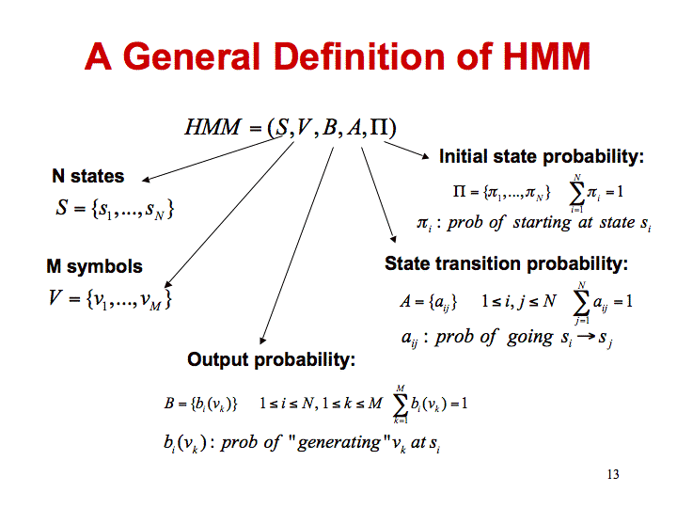
Hidden Markov Model
* Hidden Markov Model is a statistical Markov model
in which the system being modeled is
assumed to be a Markov process with
unobservable states.
* The hidden Markov model can be represented as
the simplest dynamic Bayesian network

Slide 54
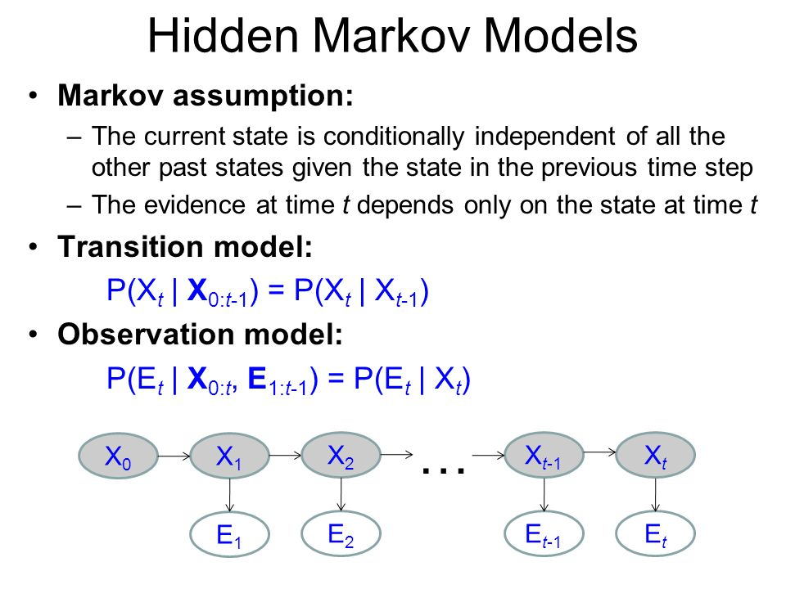

Slide 55
HMM ( Hidden Markov Model ) a visualisation
For instance taking 12 dices for a 6 node HMM
Hidden States : (p,q,r,s,t,u)
Observation : (1 …. 6)
Hidden State Transition
(Probability of transition to / from a Hidden state )
1 …. 6
1 …. 6
5
4
q
r
1 …. 6
1 …. 6
6
p
1
p
State transition
based on Previous state
s
Observation state transition
( Probability of an Observation
in a hidden state )
1….6
1….6
u
6
1
t
2

Slide 56
HMM ( Hidden Markov Model ) an Example
For instance taking 12 dices for a 6 node HMM
Hidden States :
(sunny,rainy,cloudy,windy)
Observation:
(Temperature in ‘C )
Hidden State Transition
(Probability of transition to / from a Hidden state )
0’C to 45’C
0’ C to 45’C
29’C
14’C
sunny
rainy
Hidden state transition based on previous state
sunny
Cloudy
Observation avg temperature
( Probability of an Observation
in a hidden state )
windy
17’C
20’C
17’C
0’C to 45’C
0’C to 45’C

Slide 57
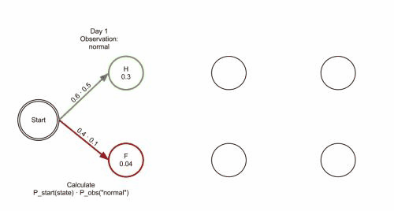
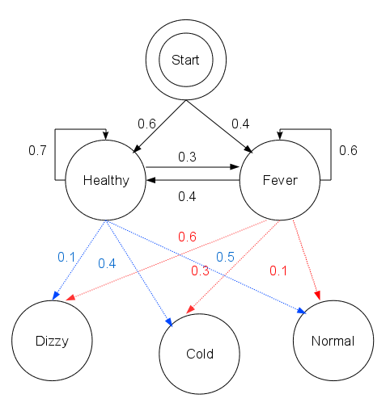
HMM, Most probable Hidden sequence: Vitterbi
This algorithm generates a path , which is a sequence of states that generate the observations with where is the number of possible observations in the observation space
.
HMM
Vitterbi

Slide 58
HMM Problems
* Obtain a most probable sequence ( vitterbi )
* Obtain transition Probability matrix amongst hidden states and emission Probability matrix given a bunch of sequences.
* Obtain Marginal Probability of independent random variable.

Slide 59
Markov Process
* Markov processes are stochastic processes in discrete or continuous time, that
have the Markov property.
* Markov Property is that next value of the Markov Process depends on the
current value, but it is conditionally independent of the previous values of the
stochastic process.
* The Brownian motion process and the Poisson process (in one dimension)
are both examples of Markov processes in continuous time,
* Random walks on the integers and the gambler's ruin problem are examples
of Markov processes in discrete time.
* Markov process are the basis for a general stochastic simulation method known
as Markov chain Monte Carlo, which is used for simulating random objects with
specific probability distributions, and has found application in Bayesian statistics.

Slide 60
Random Field
Random Field:
* A random Field is a random function over an arbitrary domain (usually a multi
dimensional space such as R^{n} or some other domain).
* It is also sometimes thought of as a synonym for a stochastic process with some
restriction on its index set.
* A random field is a generalization of a stochastic process where the underlying
parameter need no longer be real or integer valued "time" but can instead take
values that are multidimensional vectors or points on some manifold (?).
* Markov property was originally for stochastic processes in continuous and discrete time, but the property has been adapted for other index sets such as n-dimensional Euclidean space, which results in collections of random variables known as Markov random fields.

Slide 61
Conditional Random Field
* Conditional Random Field is a special case of Markov Random field wherein the graph satisfies
“ When we condition the graph on X globally i.e. when the values of random variables in X is fixed or given,
all the random variables in set Y follow the Markov property
p(Yᵤ/X,Yᵥ, u≠v) = p(Yᵤ/X,Yₓ, Yᵤ~Yₓ),
where Yᵤ~Yₓ signifies that Yᵤ and Yₓ are neighbors in the graph.”
* A variable’s neighboring nodes or variables are also called the Markov Blanket of that variable.
* CRFs is for sequence modeling.
* A CRF can take context into account predicts sequences of labels for sequences of input samples.
* CRFs are a type of discriminative undirected probabilistic graphical model.
* They are used to encode known relationships between observations and construct consistent interpretations and are often used for labeling or parsing of sequential data such as POS tagging, shallow parsing, named entity recognition

Slide 62
Topic Modelling
* Latent Symantic Indexing(LSI)
= SVD + Topic Modelling
* Latent Symantic Analysis (LSA)
= LSI on Documents
* Probabilistic Latent Symantic Analysis(PLSA)
= LSA Following Bayesian Probability
* Latent Dirichlet Allocation (LDA)
= PLSA with Dirichlet Priors

Slide 63
Latent Dirichlet Allocation
Latent Dirichlet Allocation is a Topic Modelling technique for Document Clustering
It uses Dirichlet Distribution ( generalisation of multinomial distribution) as a prior.
It follows Numerical methods iteratively for estimation of :
1. Probability of Topic to Doc match using a 2D array of floats for topics vs Docs.
2. Probability of word to Topic match using a 2D array of floats for words to Topics.
Iteratively the Probability values of these two matrices are updated and matured
through optimisation using following till convergence :
* Gibbs Sampling (sequential , slow , asymptotically accurate )
* Expectation Maximization (partially distributable and faster, accurate)
* Online Variational Bayes ( fast and approximately )

Slide 64
LDA and an Iteration
Two matrices Topic to Doc and Word to Topic provides the Probability of matching for Topic to Doc and Word to Topic respectively.
.As number of docs increases matrix Topics to Doc increases .
As number of Topics increases , both matrices size increases .
As vocabulary increases in corpus , matrix Word to Topic increases.
An iteration: Sampling via Gibbs Sampling or Expectation Maximization or Online Variational Bayes samples a part of corpus and updates a part of matrices and other parts remain as before .

Slide 65

LDA Joint Probability Distribution
=> weights for K Topics for Docs
(Dirichlet Prior )
=> weights of word w of V (Vocabulary) for a Topic
(Dirichlet Prior)
=> Word Distribution across K Topics
=> Topic distribution for M docs
=> Identity of Topic for word w in doc d
=> Identify of word w in doc d
Capitals are vector forms of Random Variable .

Slide 66
Practical LDA and Number Of Iterations
So If number of iterations is increased , more parts of matrices are updated probabilistically. The probability of most of matrices maturing is higher.
For same number of iterations, the probability of match will slide as number of topics is increased / or vocabulary is increased.
Thus, the number of iterations must be proportional to vocabulary of corpus , number of docs and number of topics.
K ∝ T*D*V
T-> Num of Topics D -> Num of Docs
V- > vocabulary of Corpus K -> num of Iterations

